Slide 1

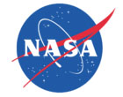

Development and Test of a Fresnel-Based Solar Concentrator for Lunar Greenhouse Applications
Derek Wibben
Mentor: Dr. Roberto Furfaro – Systems Engineering
Affiliated With: Sadler Machine Co.

Slide 2
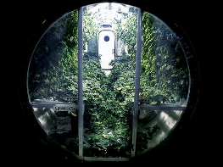
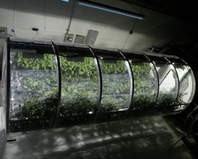
Introduction
Length of manned space exploration is largely based on energy availability
Solution: Bioregenerative Life Support System (BLSS)
Popsci.com
Earthsky.com

Slide 3
Introduction
Micrometeorites strike the lunar surface at a high rate
Greenhouse must be placed underneath the lunar regolith
A lighting system is required for plant growth
Energy limitations rule out artificial lighting

Slide 4
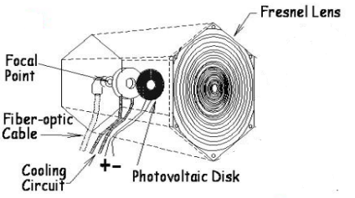
Himawari Solar Lighting System
Fresnel Lens
Quartz Glass Fiber-Optic Cables
Acrylic Capsule

Slide 5

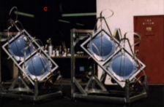
Alternative Methods
Parabolic Reflecting Dish

Slide 6
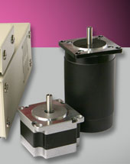
Development and Progress
Development of combination Closed Loop and Open Loop system with Visual Basic
MD2 Stepper Motors by Arrick Robotics
Open Loop: Solar Angle
algorithm
Closed Loop: Photovoltaic
cells for solar tracking
Arrickrobotics.com

Slide 7
Testing and Future Plan
Testing will result in values for:
Overall Photosynthetic Efficiency
Photosynthetic Spectral Efficiency
Future Work
Photovoltaic Cells for electricity generation
Utilizing Infrared and UV light
LEDs for supplemental lighting

Slide 8

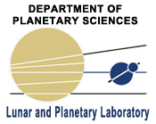
Acknowledgements
Roberto Furfaro
Phil Sadler
Neal Barto
Gene Giacomelli
David Story
Stan, Cindy, and Dan Wibben

